Slide 1
How to Become an EPO FRS Operator!
Amal Moulik
Christine Monsen
Rossmoor EPO Communications Team
epocomms@gmail.com

Slide 2
Why Become an FRS Operator?
To help yourself and your neighbors during an emergency
To report on the status of your entry/street following a disaster/emergency
To provide a way to reach professional first responders if 911 is overwhelmed and cell phone towers are down

Slide 3
Why Spend 30 Minutes Networking on Saturdays?
Familiarity
With your FRS radio and how to use it on the network
With the voices of your neighbors
Practice
Sharing the network with other FRS operators
Following instructions from the Net Control Operator (NCO)
Using your personal identifier: first name, street, entry (or no entry)
Finding the best location to call from

Slide 4
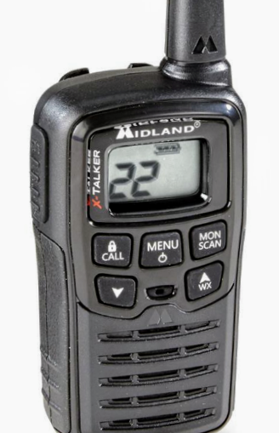
Standard Controls of FRS Radios
PERMANENTLY ATTACHED ANTENNA
PUSH TO TALK BUTTON (PTT)
POWER/MENU BUTTON
BUILT-IN MICROPHONE
SPEAKER

Slide 5
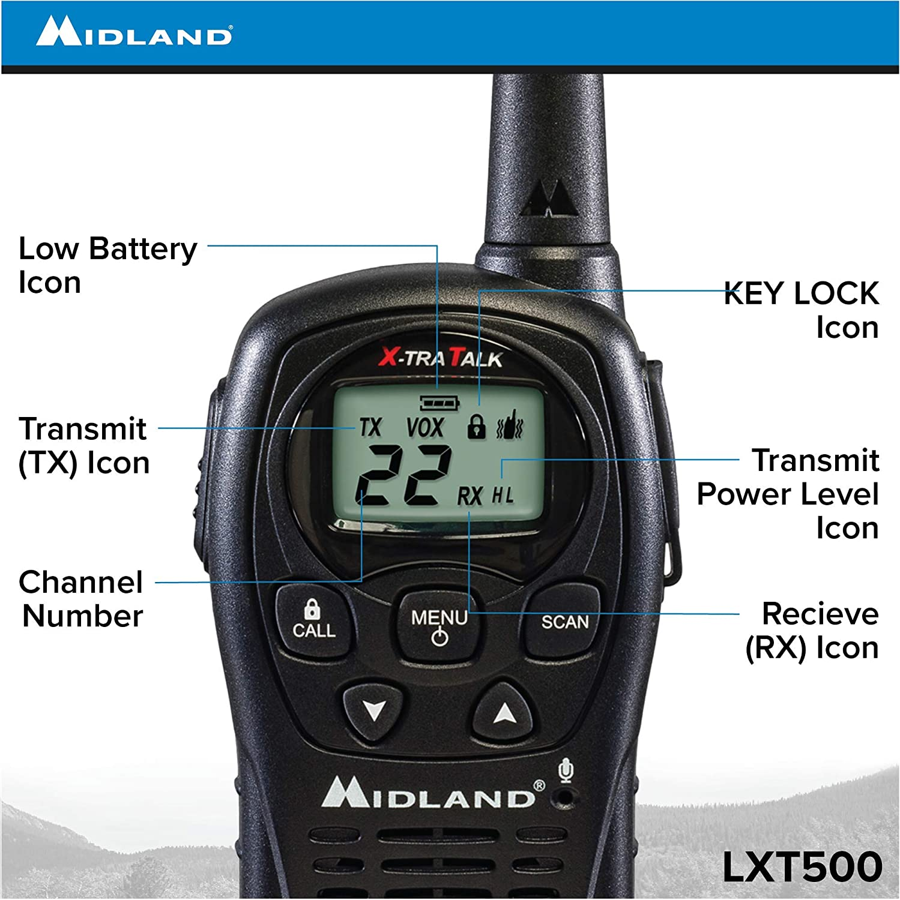
FRS Radio Icons and Operations
These radios typically use either rechargeable battery packs, AA or AAA batteries. Make sure that you have extra batteries for your radio, since you may not be able to recharge your battery pack during an emergency
The presence of large buildings, trees, etc., may reduce their range
Please refer to the manual for your radio (downloadable online)

Slide 6
Changing Channels on FRS Radio
Turn radio on
Press MENU Button ONCE to enter Setup mode
Large Channel Number begins flashing – use Up and Down buttons to set desired channel
Press PTT (Push to Talk) button on side of radio to exit Setup

Slide 7
FRS Radio Icons

Slide 8
During a Local Event
CERT will not be activated if the emergency does not affect a wide-area
Turn FRS radio to channel 8
Use this channel to inform others if you have “eyes” on the situation

Slide 9
Problem/OK
No longer RED/GREEN, now PROBLEM/OK
PROBLEM: Resident injuries, structural damage, blocked access
OK: Entry/Street does not need assistance
DO NOT call in OK until the PROBLEM areas have reported!

Slide 10
During a Large-Area Emergency or Disaster
CALL 911 to report all life-threatening situations
Turn to channel 8 and LISTEN for announcements from CERT
ASSESS the status of your entry/street with your EPO Coordinator and/or EPO team
Determine if your area has a PROBLEM or if it is OK

Slide 11
Any crime in-progress (robbery, burglary, prowler, fights, etc.)
Any other life threatening situations (traffic accident with injuries, etc.)
A serious medical emergency (chest pains, seizures, bleeding, etc.)
Any type of fire (structure, vehicle, brush, etc.)

Slide 12
The Process In Rossmoor
In an emergency, all FRS operators should tune to Channel 8 and listen for directions from CERT Control, who will provide information about the emergency or disaster and alert FRS operators when CERT is ready to receive reports
When directed to do so by CERT Control, change the channel to either 12 or 13, depending on where you live. FRS operators living north of Stanley Dollar Drive would choose channel 12 and those south of Stanley Dollar Drive would turn to channel 13
Listen and wait your turn to speak. Then say, for example, “Control, this is Amy, Oakmont Drive Entry X” and wait to hear Control say “Amy, go ahead” before speaking
It is critical to keep your radio on for the duration of the emergency, so that you can be contacted if additional information or assistance is needed from you

Slide 13
Simplifying the Reporting Process
After carefully assessing the emergency or disaster, take a moment to think about how to communicate it accurately and only report relevant information.
FRS operators follow established reporting guidelines: Who, What, and Where. They then wait for confirmation to ensure that CERT has received and recorded the information accurately.
WHO: First name, street and Entry number (if any) where you live
WHAT: Major injuries, Significant building damage & Blocked access
WHERE: Exact location of the incident

Slide 14
Wireless Radio Etiquette
GOLDEN RULES OF COMMUNICATING:
A Wireless Radio is not a Telephone!
When YOU talk, you can’t hear
When YOU talk, no one else can talk
If EVERYONE talks, NOBODY understands
We listen, speak clearly and get the message across using few words
We organize our thoughts before transmitting. When you are ready to transmit press the Push To Talk (PTT) button, also known as the Plan To Talk button on the side of the radio.

Slide 15
Wireless Radio Etiquette
Reports of PROBLEMS (major injuries, significant building damage, and blocked access) always go before OK reports
We share a common radio channel. Two people can’t talk at the same time. One person, Control, directs who speaks first
To initiate communication, we contact Control, “Control, this is Amy Oakmont Drive Entry X”. Control responds with “Go ahead Amy,” or “Stand by….,”
While communicating, we frequently use “Copy” to acknowledge, “Repeat” to request say again, “Over” after each transmission and “Clear” to end this report. (The FRS operator keeps her/his radio on)

Slide 16
Want to Help Out?
Become an FRS radio operator and/or EPO coordinator or assistant
Stay on for the full 30 minutes on Saturday EPO networking sessions
Relay if a caller is not being heard by the Net Control Operator (NCO)
Get trained as the NCO so you can step in if needed
Participate in future EPO/CERT training/drills about how to report PROBLEM situations

Slide 17
Need FRS Training?
Contact Amal and Christine at epocomms@gmail.com to set up a session
Make sure that you are an EPO member so you get announcements about future training sessions on the FRS radios
Join drills with CERT once they are up and running, and we can gather together

Slide 18
Thank You for Volunteering as an FRS Operator!
Thanks to John Trinterud and Steve Adza for establishing the FRS radio networks here in Rossmoor and for their long years of stellar service
Thanks to Al Kadosh and Tori Maxfield for some of these slides, and Harris Greenberg for his finishing touches

