Slide 1

The basics of calling 911
Walnut Creek Police Department

Slide 2

Today we will talk about:
What is the Dispatch Center?
What do the Dispatchers do?
Important numbers to know
When to call 911
What to expect when calling 911
The difference between using Cell Phones and Landlines to call 911
Online Reports
Scams

Slide 3
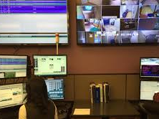
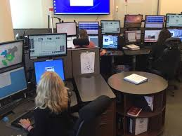
What is the Dispatch Center?
Dispatch is staffed at ALL times.
This means 24 hours a day, 7 days a week,
365 days a year.
Current staffing is:
10 Full-Time dispatchers
2 Part-time dispatchers
2 Per-diem dispatchers
The Dispatch Center has four 911 lines, six 10-digit emergency lines, and five incoming non-emergency lines.

Slide 4
What do the Dispatchers Do?
ANSWER INCOMING EMERGENCY AND NON-EMERGENCY PHONE LINES
FIELD INCOMING REQUESTS FROM POLICE OFFICERS ON PATROL VIA RADIO
DETERMINE THE PROPER ACTION FOR INCOMING PHONE CALLS
OPERATE MULTIPLE DIFFERENT COMPUTER SYSTEMS SIMULTANEOUSLY
KEEP IN MIND SOMETIMES THERE ARE ONLY 2 DISPATCHERS ON DUTY AT ONE TIME!
BRIEF AND CONCISE RESPONSES HELP US HELP YOU!

Slide 5
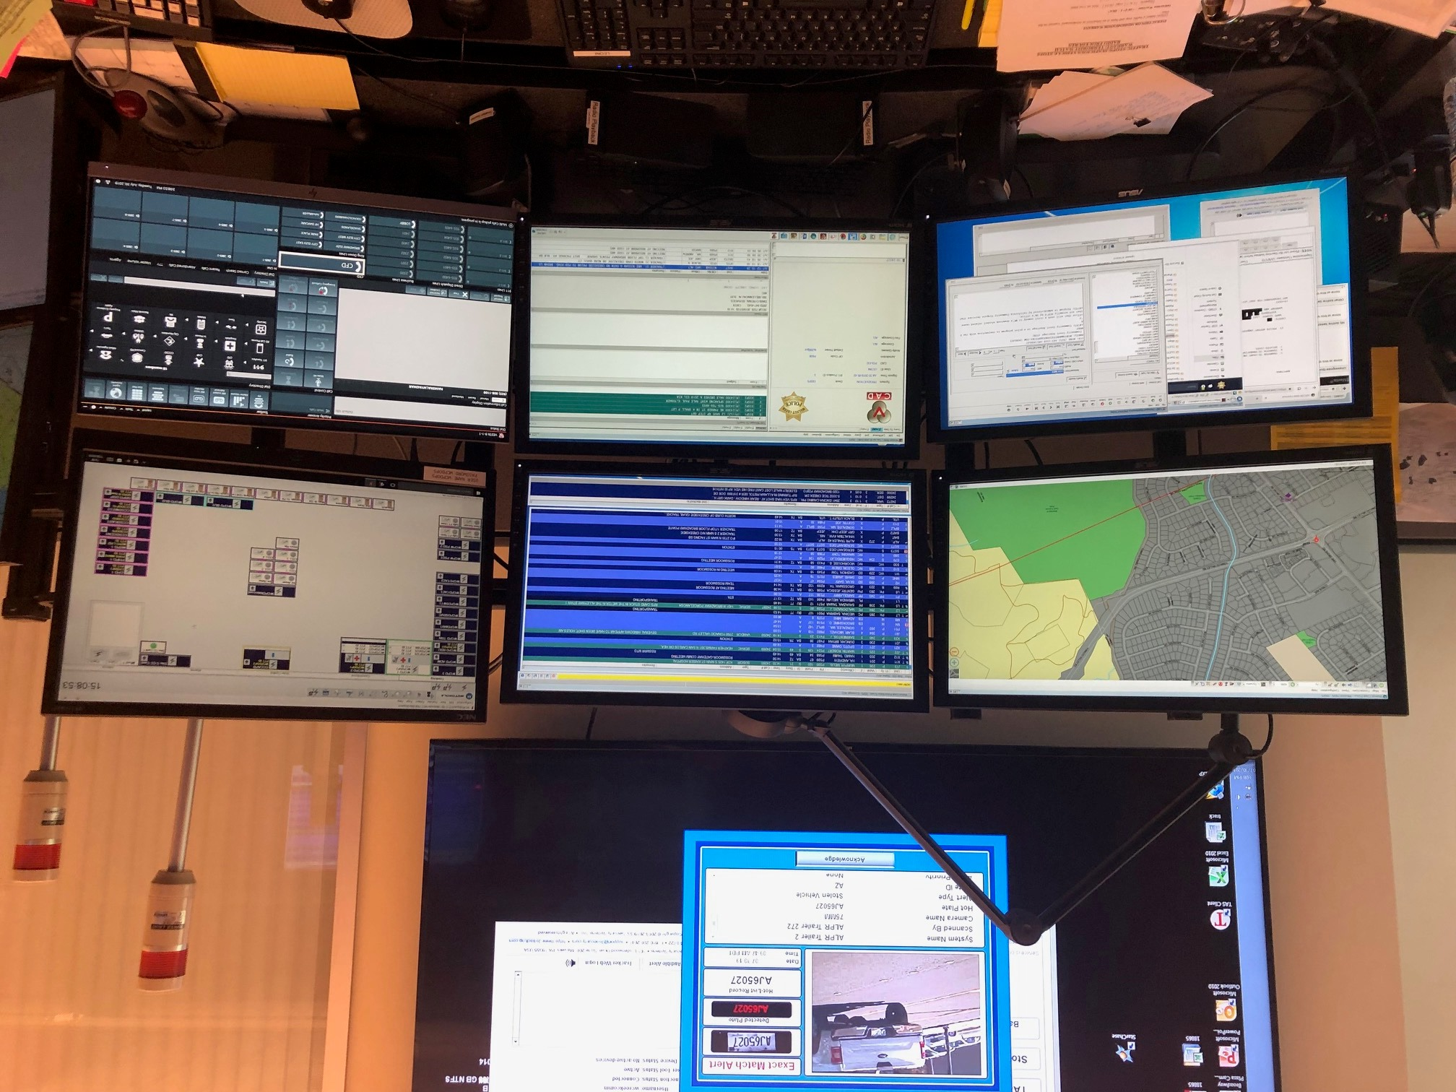

Slide 6
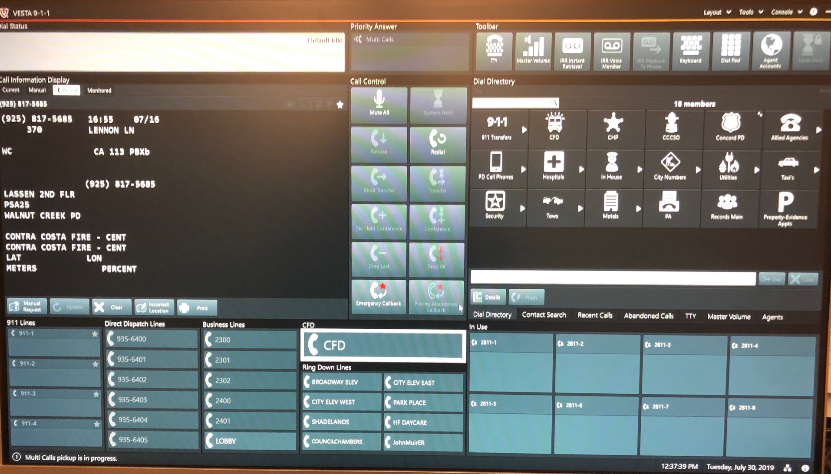

Slide 7

Police Department Phone Numbers
911 is for LIFE or DEATH emergencies
Emergency Line: 925-935-6400 : This number will get you directly to a dispatcher. This is the number you need to program into your cell phone, in case you ever need to reach the Walnut Creek Police Department urgently.
Non Emergency Number: 925-943-5844 – this line is for general information and questions. Or if you need to report an incident that is not occurring at this time.

Slide 8

Any crime in-progress (robbery, burglary, prowler, fights, etc.)
Any other life threatening situations (traffic accident with injuries, etc.)
A serious medical emergency (chest pains, seizures, bleeding, etc.)
Any type of fire (structure, vehicle, brush, etc.)

Slide 9

USEFUL CONTACT NUMBERS
• Information: 4-1-1 is a fee based directory assistance service
Phone trouble: 6-1-1
• Power outage: You should call PG&E directly at 1-800-743-5000
• Traffic information: 5-1-1 is the number for traffic information in California.
• Social services: 2-1-1 is available in California to help with health and human service needs.

Slide 10



Slide 11

Location!
Location!
Location!!!
The reason location is SO important is because we cannot send help to you if we do not know where you are.
Land lines (aka Home Phones) are already programmed to route 911 calls to the appropriate 911 answering center and automatically displays the callers phone number and address.
Cell Phones operate much differently. Cell phone 911 calls are routed to the nearest cell phone tower, which then bounces the 911 call to the nearest 911 answering center. Technology has gotten better at making sure cell phone callers reach the correct nearest 911 answering center, however, it is not 100% accurate and sometimes if the cell phone towers are busy, your call may get bounced to a farther tower, causing you to reach a farther dispatch center.
In addition to this, cell phone 911 calls do not display your location to the 911 call center. This is why it is very important to give your location when calling from a cell phone.

Slide 12
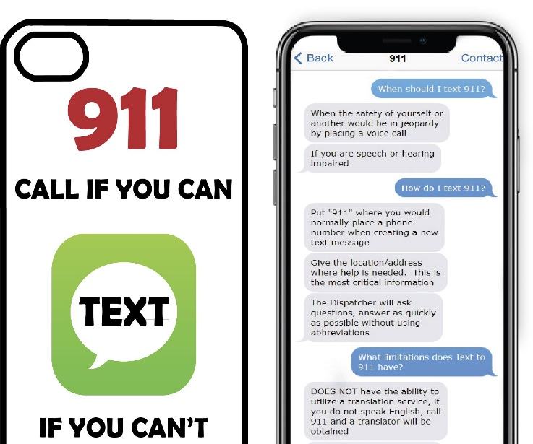


Slide 13

Lock your cell phone before putting your phone in your pocket or purse.
If you dial 911 in error, stay on the line and inform the Dispatcher.
WCPD receives approximately 20 accidental 911 calls per day.

Slide 14

www.WalnutCreekPD.com
Reporting:
Online reporting is a convenient way to report certain crimes.
In order to use online reporting the crime must meet certain criteria:
  Must have occurred in the city of Walnut Creek
  Must not be an emergency or In Progress
  Must not be a violent crime or involve any injuries
  Cannot have any suspect information – if you possibly know who committed the crime, or have video surveillance or pictures then you will need to call the dispatch center to have an Officer investigate the crime.
  *You must have a valid email address to use the online crime reporting system

Slide 15

    Steps to make an Online Report
Go to: www.WalnutCreekPD.com
Click on ONLINE REPORTING near the top of the page.
You will then see a page that says ONLINE CRIME REPORTING (this page will have a lot of information to help you decide if an online report is the best option for you).
If you decided that you want to file a report you need to scroll down to the bottom of the page and you will see: Click here to file a police report online
After clicking you will see a page titled: MAKE AN ONLINE REPORT
On this page you will see all of your choices for making an online report, with descriptions and examples of each crime. (See list in box below)
Click on the crime you are reporting, and on the next page you will see a button that says Start Report
Hit and Run Collision | Stolen Vehicle - Attempt
Non-Injury Collision | Theft
Auto Burglary | Theft from vehicle
Harassing phone calls/texts | Vandalism/Graffiti
Identity Theft | Vehicle Vandalism/Tampering
Lost Property | Violation of Child Custody Order
Mail theft | Abandoned Vehicles

Slide 16


TYPES OF SCAMS
Law Enforcement Scams
Social Security/Medicare
Faux Family Member
Lottery Scams
Fake Charities

Slide 17
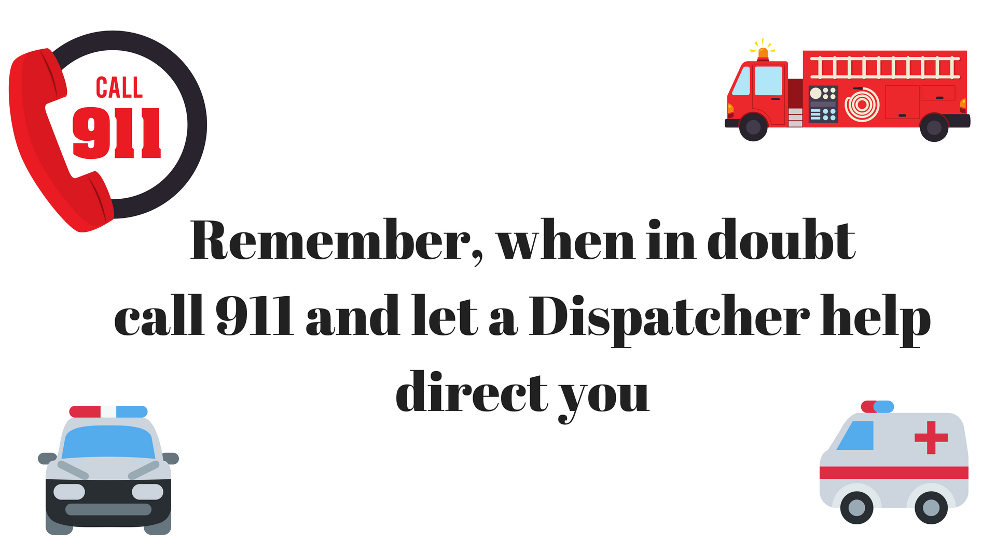

Slide 18
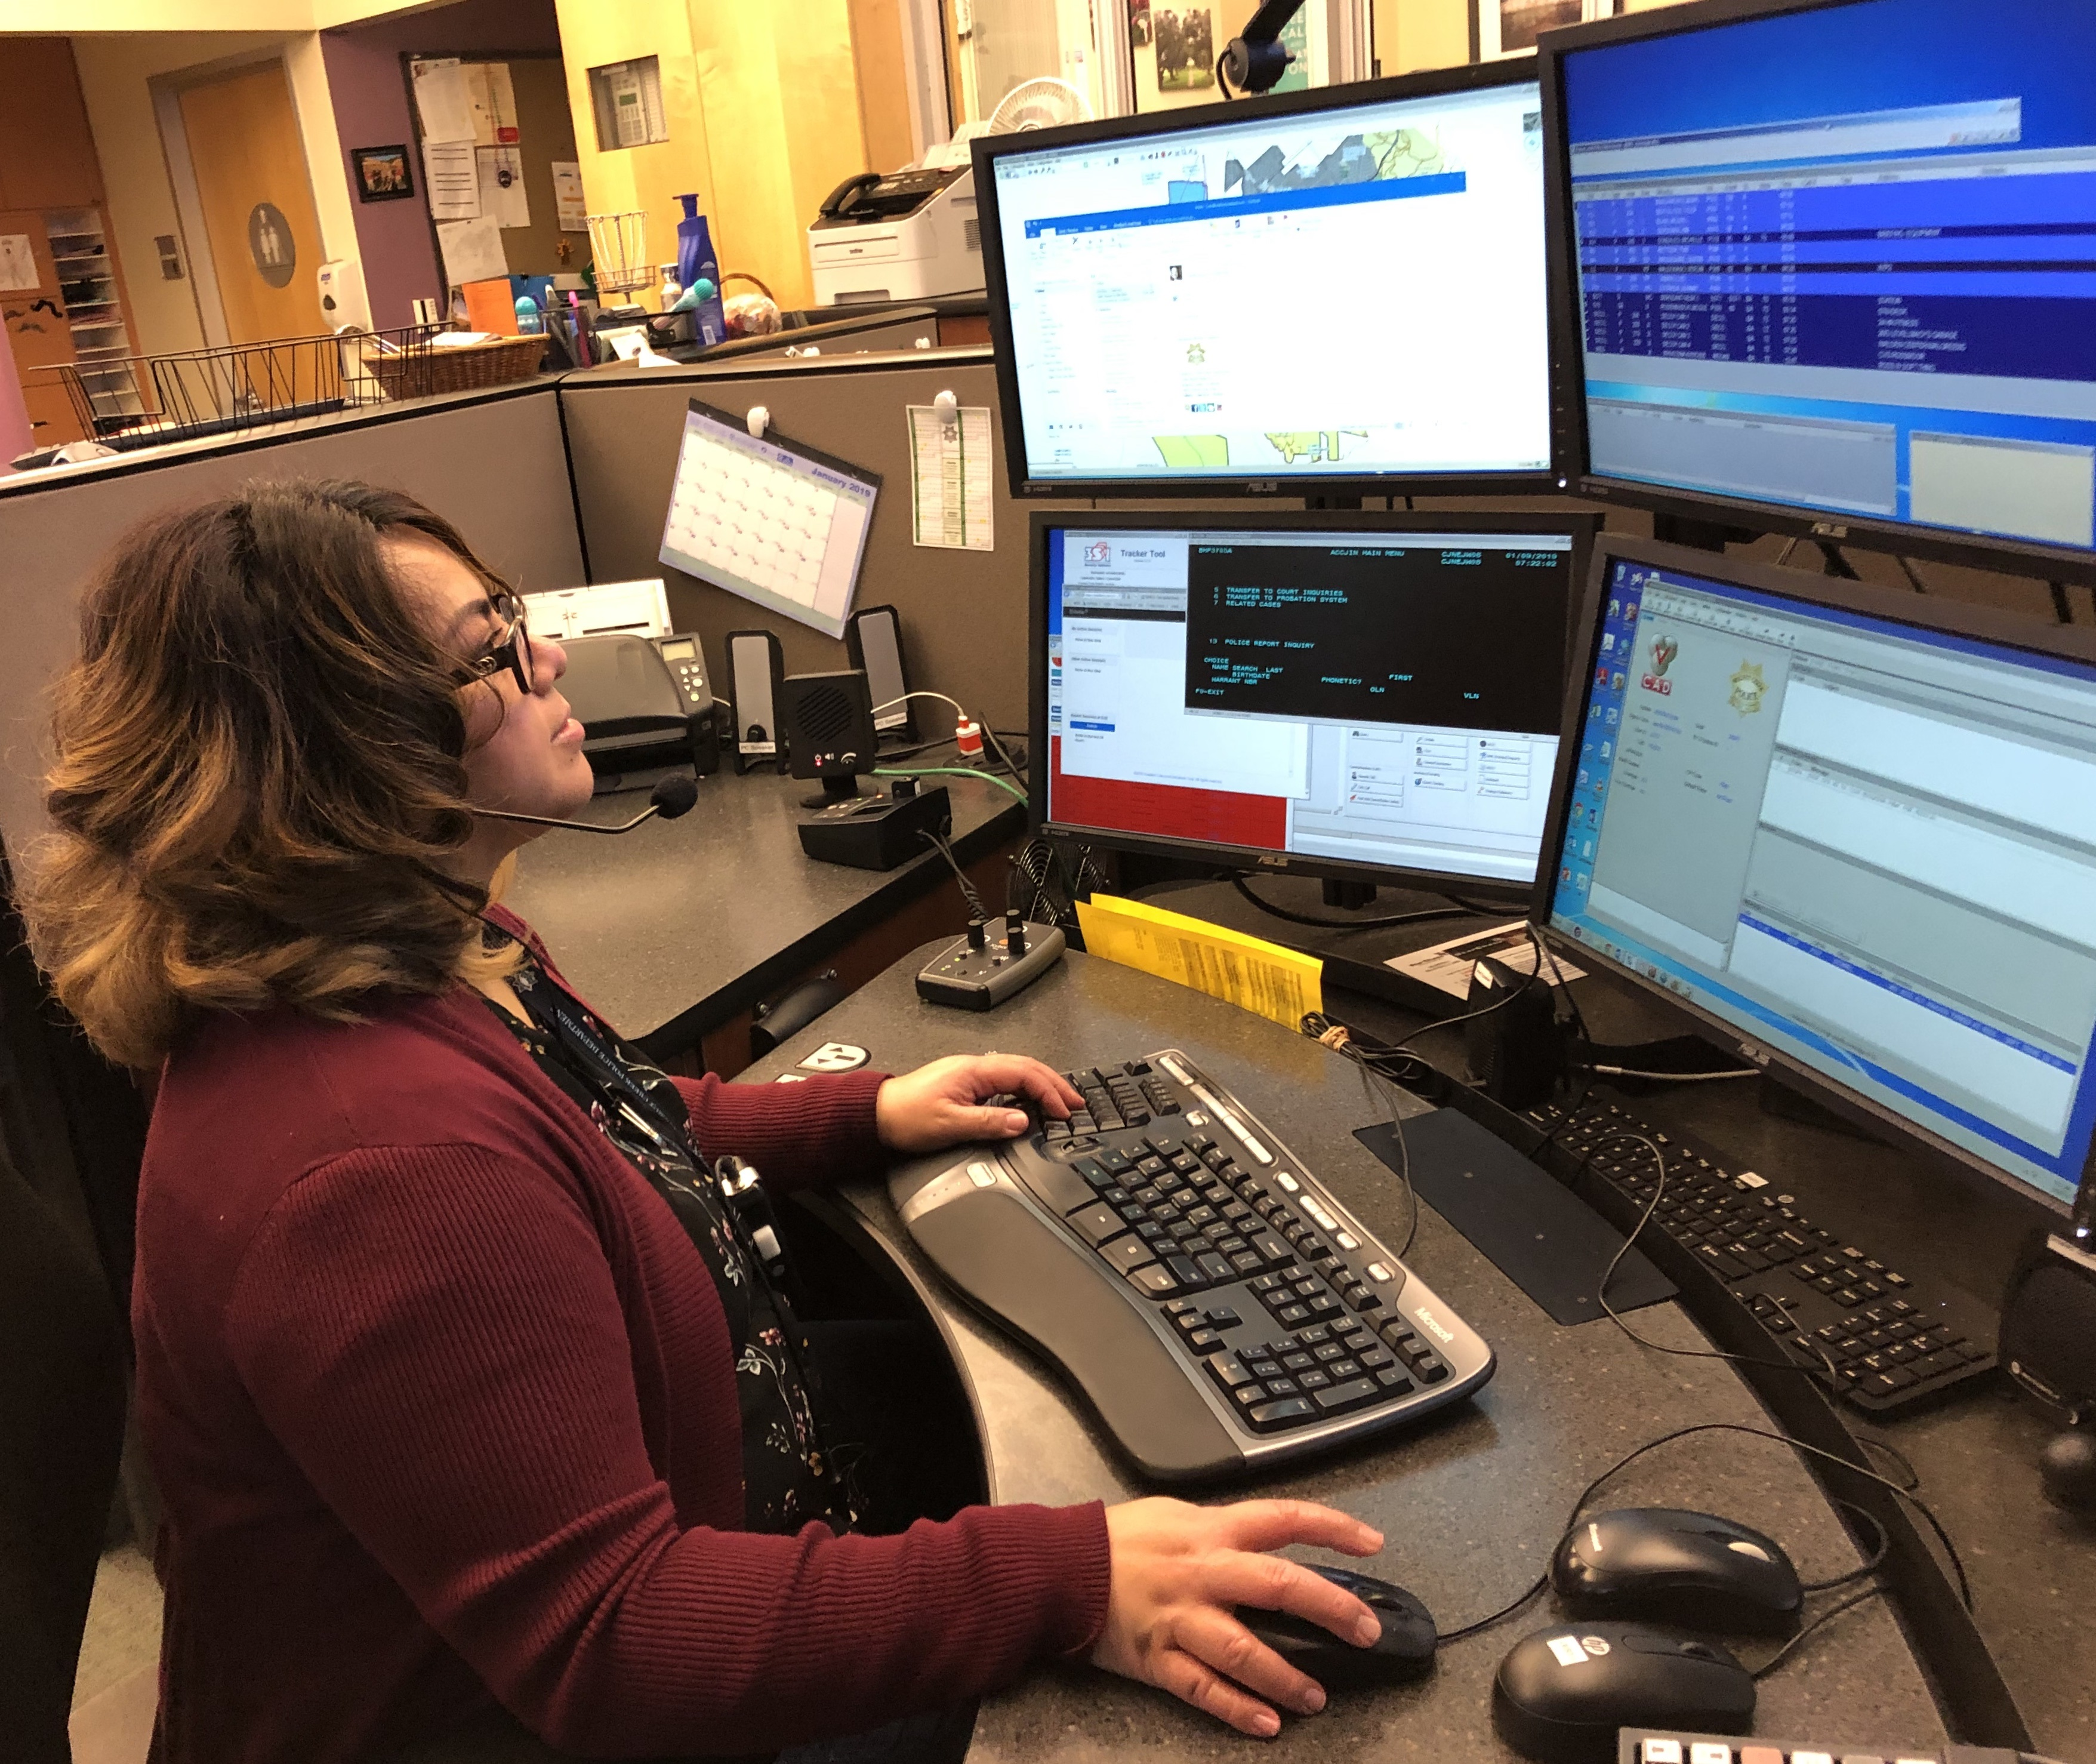


Questions?

Slide 19

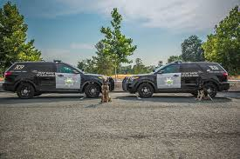
www.WalnutCreekPD.com
925.935.6400

