Slide 1
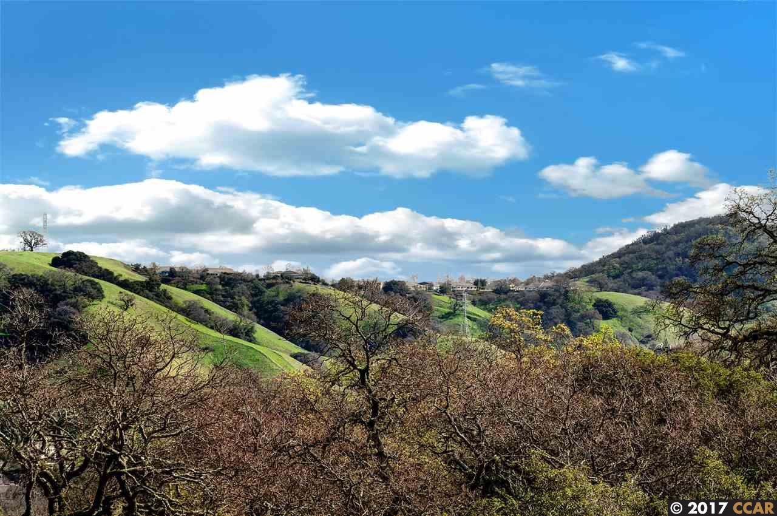

ROSSMOOR
WALNUT CREEK
Golden Rain Foundation
Emergency Operations Plan
EPO Presentation
August 3, 2020
Notes:
I’ll do introduction and set background for how we got to this point and hiring ELA.

Slide 2

ROSSMOOR
Golden Rain Foundation
Emergency Operations Plan Update
WALNUT CREEK
Ellen Lopez and Associates Team
Ellen Lopez
President
Certified Emergency Manager
30 Years of Experience
  County of Orange, CA
  City of Santa Monica, CA
  City of Anaheim, CA
  Emergency Management Assessment Program (EMAP) Assessor
David Lopez
Vice President
Project Manager
Orange County Fire Authority 33 years
Air Operations Branch Director on CalFire
Incident Management Team #1
Subject Matter Expert, Department of Defense (DoD)
Support for Domestic Disaster Assistance
Notes:
Add a brief bio of the team members.

Slide 3
ROSSMOOR
Golden Rain Foundation
Emergency Operations Plan
WALNUT CREEK
The Planning Process
Step 1
Form a Collaborative
Planning Team
Step 2
Understand
the
Situation
Step 3
Plan
Development
Step 4
Plan
Preparation,
Review
Step 5
Approval
Implementation
& Maintenance

Slide 4
ROSSMOOR
Golden Rain Foundation
Emergency Operations Plan
WALNUT CREEK
Step 1
Form a Collaborative
Planning Team
Planning Team
Golden Rain Foundation
City of Walnut Creek
City of Lafayette
Contra Costa County Fire Protection District
County Office of Emergency Services
County ARC – Disabled and Functional Needs
Red Cross
Rossmoor CERT
Rossmoor Emergency Preparedness Organization

Slide 5
ROSSMOOR
Golden Rain Foundation
Emergency Operations Plan
WALNUT CREEK
Step 2
Understand
the
Situation
Gather Intelligence
  Two Planning Team Meetings
  Tour of Alternate Entrances with City Personnel
  GRF Board Meetings
  City Council Meeting
  County OES Evacuation Planning Workshop
Hazard Identification and Prioritization
Risk Assessment to Determine Operational Priorities
City of Walnut Creek Rossmoor Evacuation Tabletop

Slide 6
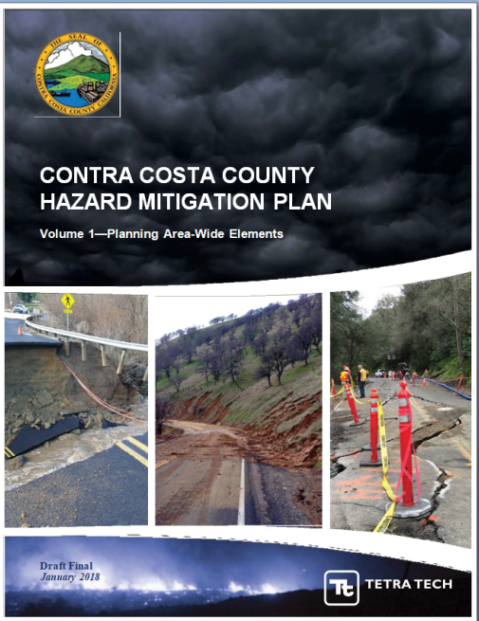
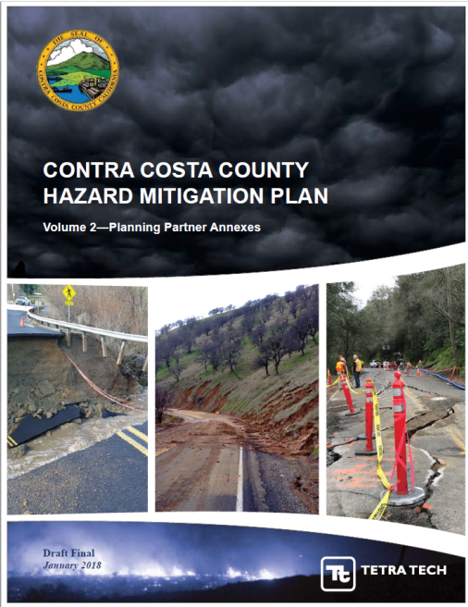
ROSSMOOR
Golden Rain Foundation
Emergency Operations Plan
WALNUT CREEK
Step 2
Understand
the
Situation
Risk Assessment
Landslide
Earthquake
Flood
Severe Weather
Wildfire

Slide 7
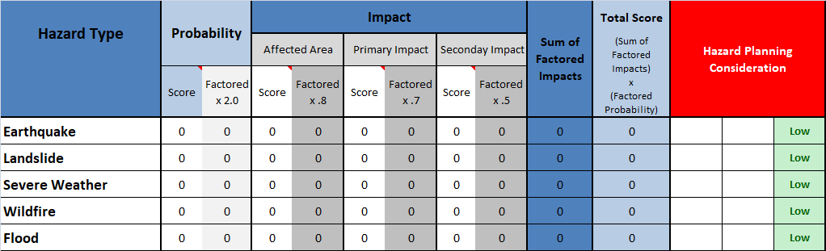
ROSSMOOR
Golden Rain Foundation
Emergency Operations Plan
WALNUT CREEK
Probability: From 1=Unlikely to 4=Highly Likely
Affected Area: How much of Rossmoor? 1=Isolated to 4=Widespread
Primary Impact: What’s the damage? 1=Negligible to 4=Catastrophic
Secondary Impact: What’s the outcome? Loss of function, downtime, evacuations. 1=Negligible to 4=High
Step 2
Understand
the
Situation
Notes:
Probability: From 1=unlikely to 4=highly likely
Impact: has three sections
Affected Area: How much of Rossmoor? 1=Isolated to 4=Widespread
Primary Impact: What’s the damage? 1=Negligible to 4=Catastrophic
Secondary Impact: What’s the outcome? Loss of function/downtime/evacuations. 1=Negligible to 4=High

Slide 8
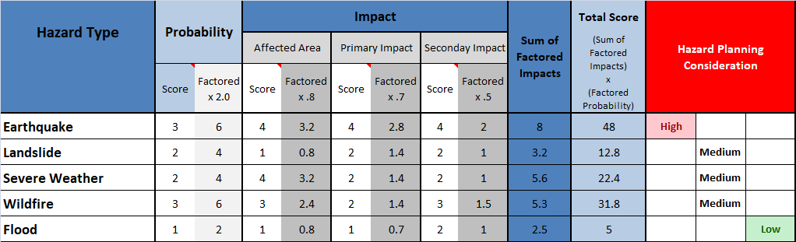
ROSSMOOR
Golden Rain Foundation
Emergency Operations Plan
WALNUT CREEK
Step 2
Understand
the
Situation
Probability: From 1=unlikely to 4=highly likely
Affected Area: How much of Rossmoor? 1=Isolated to 4=Widespread
Primary Impact: What’s the damage? 1=Negligible to 4=Catastrophic
Secondary Impact: What’s the outcome? Loss of function, downtime, evacuations. 1=Negligible to 4=High
Notes:
Probability. Factored x 2.0
Affected: Factored x 0.8
Primary Impact: Factored x 0.7
Secondary Impact: Factored x 0.5
(Sum of the Factored Probability) x (Factored Impacts) = Score
Hazard Planning Consideration
0-12.0 = Low
12.1 - 42.0 = Medium
42.1 - 64.0 = High

Slide 9
ROSSMOOR
Golden Rain Foundation
Emergency Operations Plan
WALNUT CREEK
Step 2
Understand
the
Situation
Risk Assessment
Prioritization for Rossmoor
Earthquake
Wildfire
Severe Weather
Landslide
Flood

Slide 10

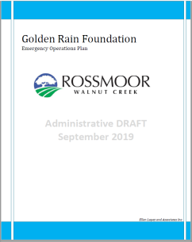
ROSSMOOR
Golden Rain Foundation
Emergency Operations Plan Update
WALNUT CREEK
Step 3
Plan
Development
Components of the Plan
Section 1: Introductory Material
Section 2: Concept of Operations
Section 3: Organization and Responsibilities
GRF Rossmoor
Walnut Creek
Emergency
Operations
Plan
Section 4: Rossmoor Operations Center (ROC) Management
Section 5: Communication and Notification
Emergency
Operations
Plan
Appendices: 16

Slide 11
ROSSMOOR
Golden Rain Foundation
Emergency Operations Plan
WALNUT CREEK
GRF Emergency Management Structure
Operational Area (OA) EOC
City of Walnut Creek EOC
CERT
Policy Group
Golden Rain Foundation Board of Directors
Liaison/Legal Officer
Foundation CEO
ROC Director
Public Safety Manager
Public Information Officer
Director of Communications
Operations
Section
Director of Mutual Operations
Planning/Intel
Section
Director of Resident Services
Logistics
Section
Fleet & Compliance Supervisor
Finance/Admin
Section
Chief Financial
Officer
Notes:
Please insert chart, the chart does not copy and past properly. Briefly describe each section.

Slide 12
ROSSMOOR
Golden Rain Foundation
Emergency Operations Plan
WALNUT CREEK
Step 4
Plan
Preparation,
Review
Administrative Draft Review
Golden Rain Foundation Senior Staff
City of Walnut Creek
City of Lafayette
Contra Costa County Fire Protection District
County Office of Emergency Services
County ARC – Disabled and Functional Needs
Rossmoor CERT
Rossmoor Emergency Preparedness Organization
Rossmoor Community
Seven presentations, plan on webiste

Slide 13
ROSSMOOR
Golden Rain Foundation
Emergency Operations Plan Update
WALNUT CREEK
Evacuation
APPENDIX E: EVACUATION
The Golden Rain Foundation has no authority to order an evacuation.
Only government public safety officials can issue and enforce evacuation orders.
The Golden Rain Foundation is working closely with the City of Walnut Creek to ensure the GRF EOP supports evacuation plans developed by the City of Walnut Creek.

Slide 14
ROSSMOOR
Golden Rain Foundation
Emergency Operations Plan
WALNUT CREEK
Emergency Management Zones
Eight Geographically Predefined Zones
Allows for GRF to Manage Isolated Incidents
Can be used by the City of Walnut Creek
  Manage evacuations

Slide 15
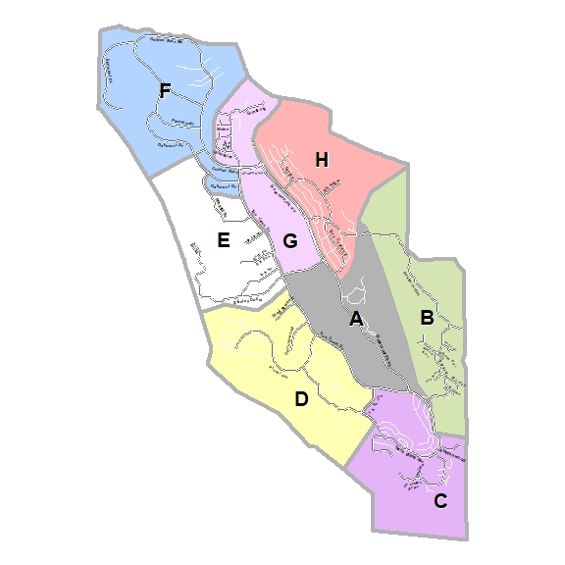
ROSSMOOR
Golden Rain Foundation
Emergency Operations Plan
WALNUT CREEK

Slide 16
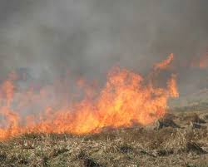
ROSSMOOR
Golden Rain Foundation
Emergency Operations Plan
WALNUT CREEK
How Fire Could Impact Rossmoor
Weather
Fuel
Topography

Slide 17
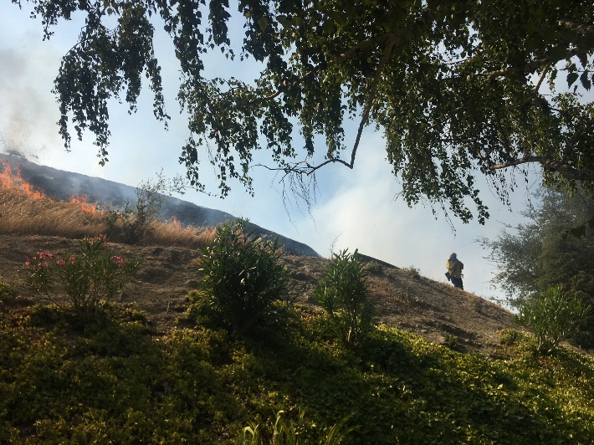
ROSSMOOR
Golden Rain Foundation
Emergency Operations Plan
WALNUT CREEK
Weather
Fuel
Topography

Slide 18
ROSSMOOR
Golden Rain Foundation
Emergency Operations Plan
WALNUT CREEK
Step 5
Approval
Implementation
Training/Socialization
& Maintenance
Approval
  Board Meeting January 14, 2020
Implementation
  Training/Socialization
  Staff
  Residents
Review Every Two Years

Slide 19


YOU’RE ON YOUR OWN
ROSSMOOR
Golden Rain Foundation
Emergency Operations Plan Update
WALNUT CREEK
YOYO
  5 to 7 days
    Water
    Food
    Medication
    Other Supplies
    Pets
Notes:
EPO has been talking about his for years. Emergency preparedness managers for Cities and County’s have been saying the same things.
GRF has a limited role in first response to disasters. If GRF did not provide you with a service prior to the disaster, please do not expect GRF to provide it after a disaster. GRF does not provide food, water, medications, electricity/gas etc. and will not be able to provide those things after.
What GRF can do is provide resources to clear road, if clubhouses are habitable, allow them to be used as shelter. MOD will work with Mutuals in their role a the management company. There are 250 GRF/MOD employees that once the event has settled down that can and will be deployed to help get GRF functioning and to help Mutuals and their residents.

Slide 20

Rossmoor Notifications
ROSSMOOR
Golden Rain Foundation
Emergency Operations
WALNUT CREEK
www.rossmoor.com
Text/email/voice
Phone Registration (925) 988-7688

Slide 21
ROSSMOOR
Golden Rain Foundation
Emergency Operations Plan
WALNUT CREEK
Questions?

