Slide 1
Emergency Preparedness Organization
April 1, 2019
Public Safety Manager Duties
Securitas Site Manager Duties
GRF and Securitas Emergency Response
Rumors, Myths and Realities
Notes:
Dennis

Slide 2
Public Safety Manager
Public Safety contract administration
GRF public safety management
Emergency/disaster preparedness
GRF
Community
GRF IIPP development and administration
OSHA compliance, oversight and training program
DOT drug and alcohol program management and oversight
Community programs and outreach
Special projects
Notes:
Dennis

Slide 3
Securitas Site Manager
Manages Securitas Account for Rossmoor Site
Staff leadership, including recruitment, development, training and counselling of 36 Security Officers
Enforcement of Policies, Procedures, and Post Orders
Primary Liaison between Securitas and GRF
Community outreach & public forum speaking for Securitas services and Emergency Preparedness
Assists GRF with security related projects
Notes:
Molly

Slide 4
Notes:
Molly

Slide 5
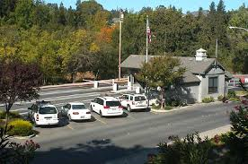
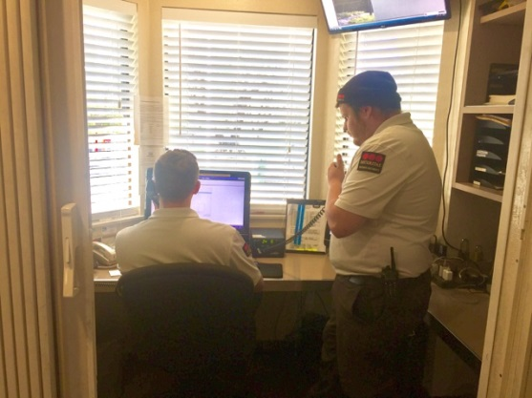
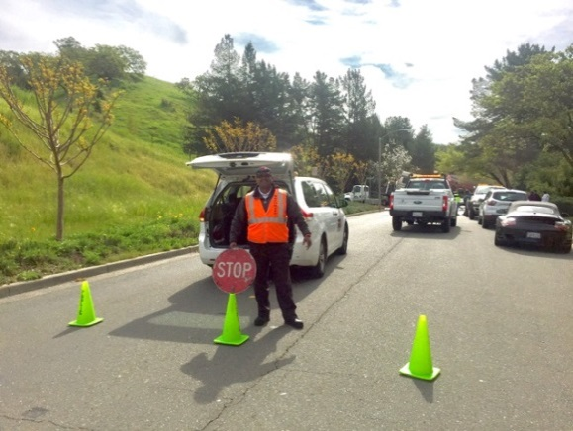
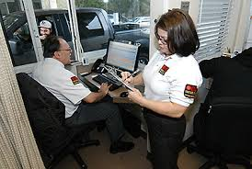
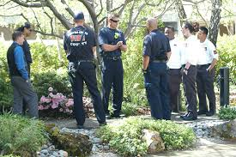
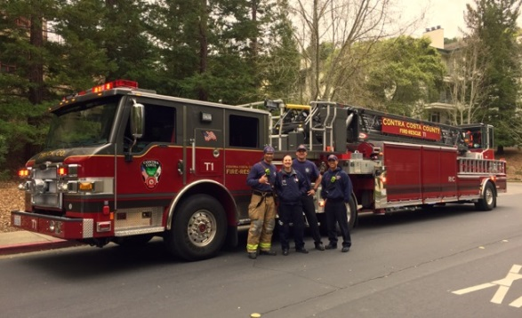
Public Safety
Notes:
Molly

Slide 6
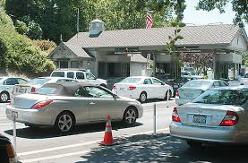
Securitas Provides Complete Public Safety Services
8,000 Calls for Service
2,500 Medicals calls
EMT’s
4,000 Miscellaneous
500 Parking Complaints
350 StairTrac Assists
3.1 million vehicles through the Front Gates
5,000 visits PS Office
12,000 access devices
Notes:
Molly
1.1 million manual
9,700 renewals
2,300 rfids issued
1200 ID cards issued

Slide 7
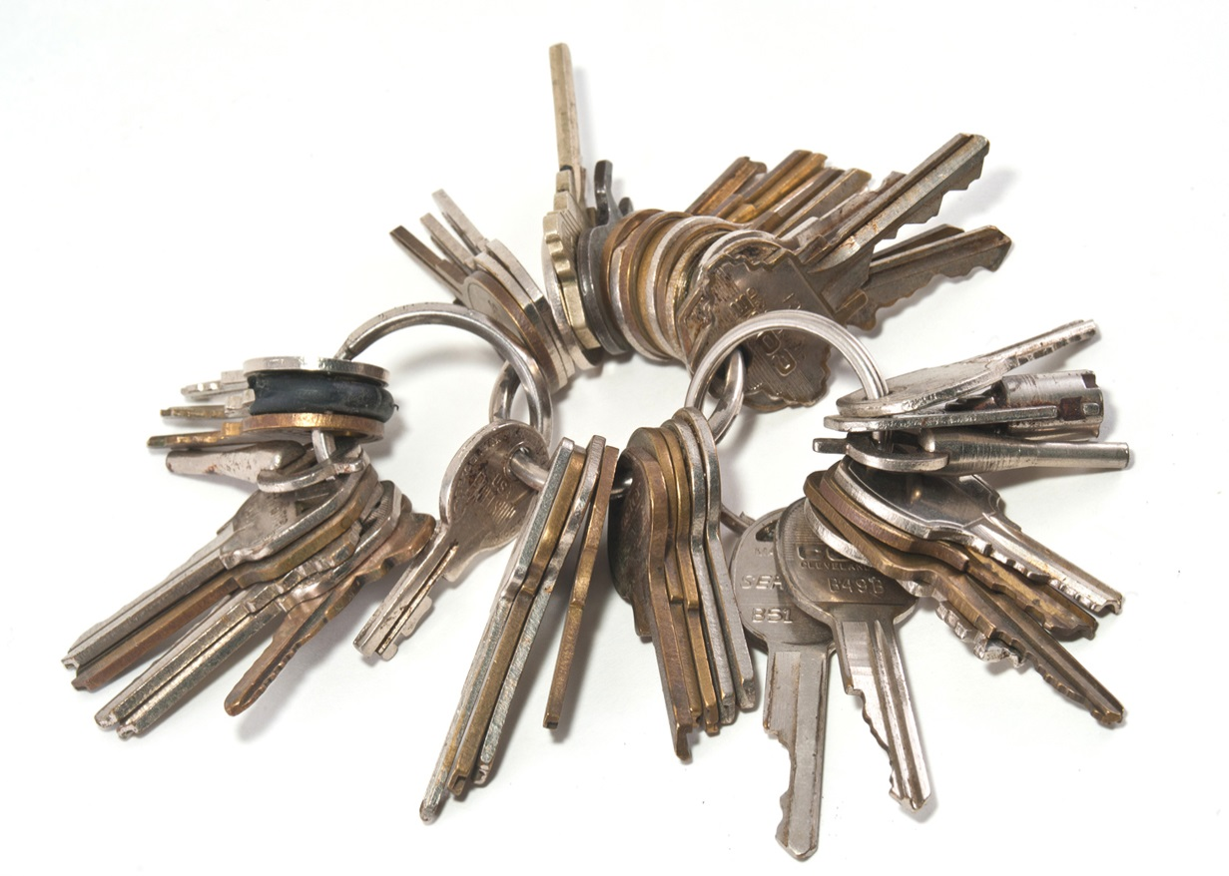
Securitas Keeps Keys to All Manors
Notes:
Molly

Slide 8
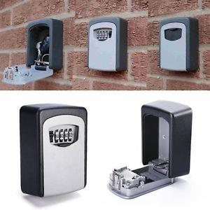
So What is Recommended?
LOCK BOX
GRF Maintains data on who has keys/lockboxes
Forms available Rossmoor.com/Public Safety Office
Fire Department maintains lockbox codes
(925) 941-3330
Email: comm-dispatchs@cccfpd.org
Notes:
molly

Slide 9
Rossmoor is a Safe Community
 | 2015 | 2016 | 2017 | 2018
Thefts | 87 | 133 | 96 | 114
Vandalism | 37 | 42 | 31 | 45
Violent Crime | 0 | 0 | 0 | 0
Notes:
Dennis

Slide 10
Traffic/Pedestrian Safety
Accidents | 2015 | 2016 | 2017 | 2018
Non-Injury | 93 | 80 | 104 | 99
Injury | 7 | 7 | 6 | 6
Notes:
Dennis
54 occurred in Lots/Entryways
20 occurred at the Gate

Slide 11
Emergency/Disaster Response
Golden Rain Foundation
Securitas
Emergency Response Plan
All Hazards Plan
Not event specific
Follows ICS
GRF emergency management
Allocation of resources
Integrated with CERT
Supplies for Staff
Integrated Response Plan
Immediate Response
Can activate GRF EOC
GRF Facility Survey
Access to Additional Personnel/Resources
Supplies for Staff
Notes:
Dennis/Molly

Slide 12
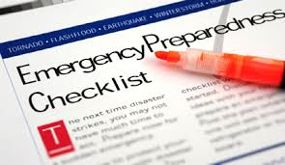
GRF WILL TAKE CARE OF ALL MY NEEDS AFTER A DISASTER
Personal
Be prepared
Have a plan
Be informed
Pets
Supplies
Food/Water
Medical
GRF
Faster Response
Dedicated Resources
Clubhouses
Red Cross MOU
Notes:
Dennis

Slide 13
IN A DISASTER, YOU’RE ON YOU OWN
Y.O.Y.O.
Notes:
Dennis

Slide 14
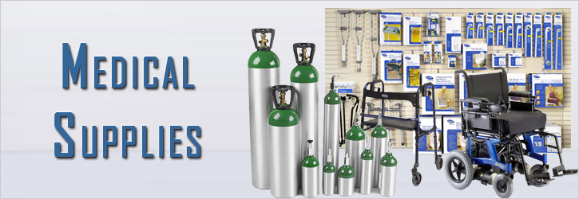
GRF CANNOT PROVIDE MEDICAL SUPPLIES
PERSONAL RESPONSIBILITY
Develop a personal plan
Maintain extra medications
Discuss with medical providers/suppliers
SUPPLEMENTAL OXYGEN
Medical treatment
Prescription/certification required
Discuss with medical provider
GRF has limited supply of oxygen
EMT emergency use
Pre-hospitalization and short term
Notes:
Dennis
Power outages examples recently

Slide 15
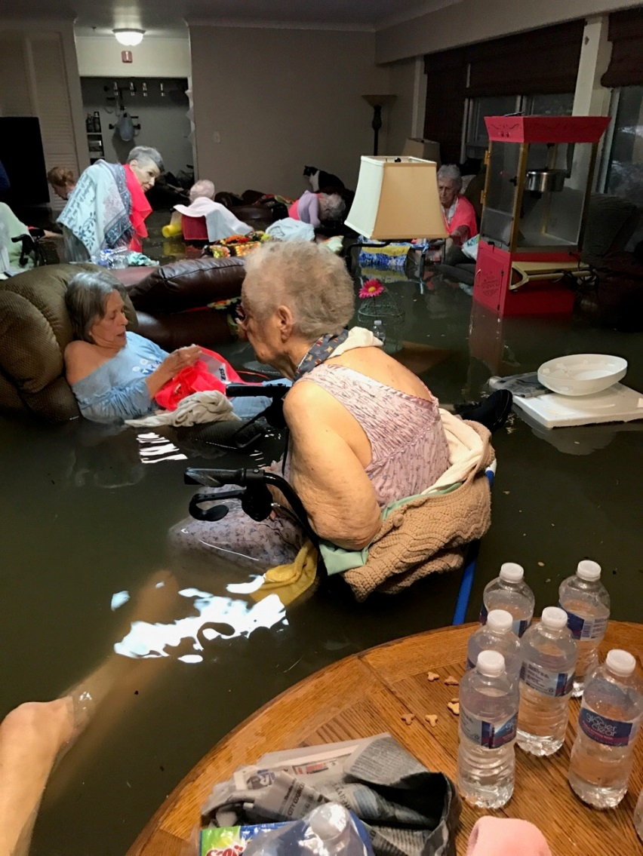
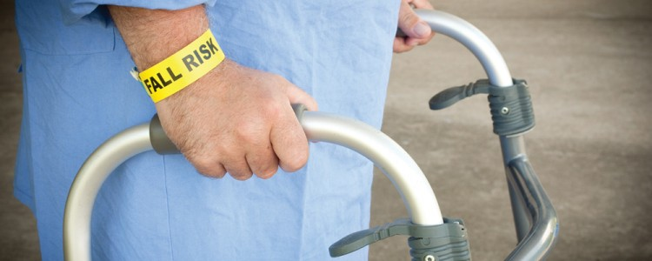
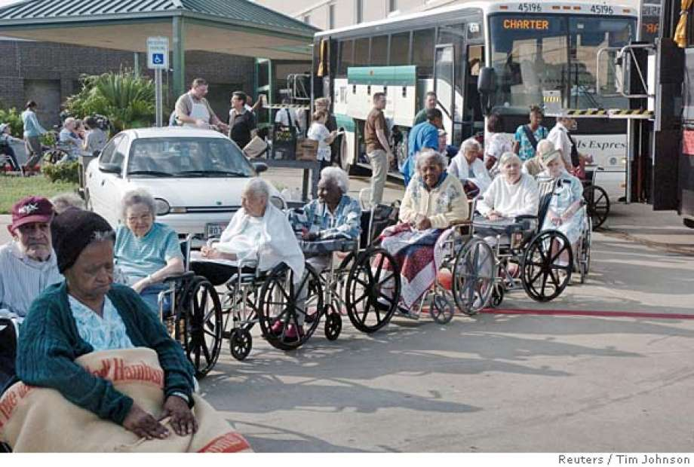
Rossmoor Residents will Not be Equipped to Handle a Disaster
Notes:
Molly

Slide 16
Care Providers are Required to Assist in a Disaster
Talk to your Care Providers
Determine what they will/won’t do during a disaster
Notes:
Molly

Slide 17
As a Community, You Can Be Prepared!
Notes:
Molly

Slide 18
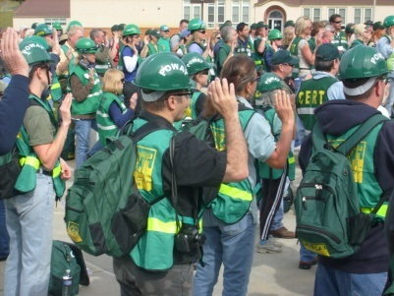
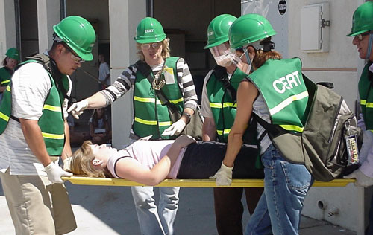
EPO and CERT Are Active and Recruiting!
Notes:
Molly
Keep an eye out CERT Features in Rossmoor News – you could be the next feature! Everyone has something to contribute
EPO – entry coordinators – do you know who your entry coordinator is? Are you interested in helping? Do you know who your neighbors are, what they may need?

Slide 19
Your Best Plan of Action is to Shelter In Place
Earthquake HazMat
Fire/Smoke Active Shooter
Notes:
Molly

Slide 20
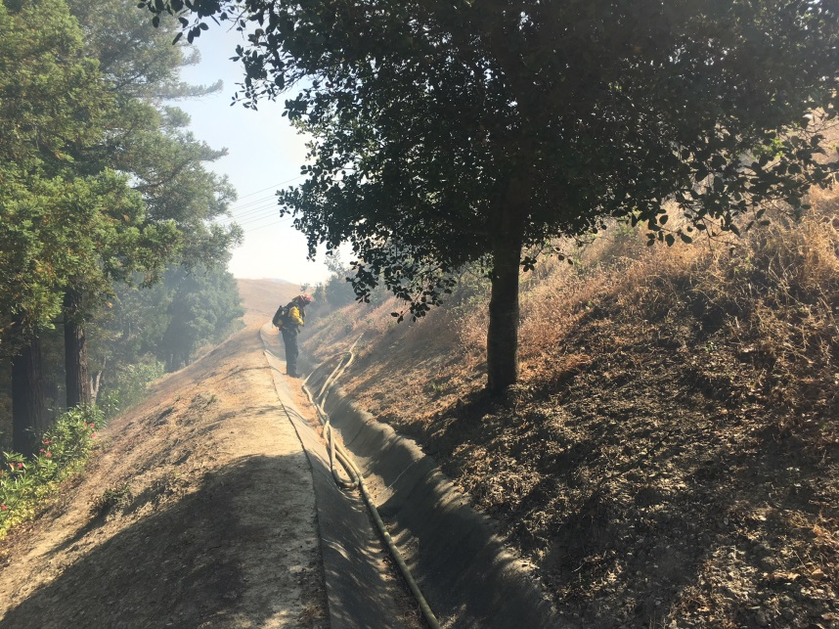
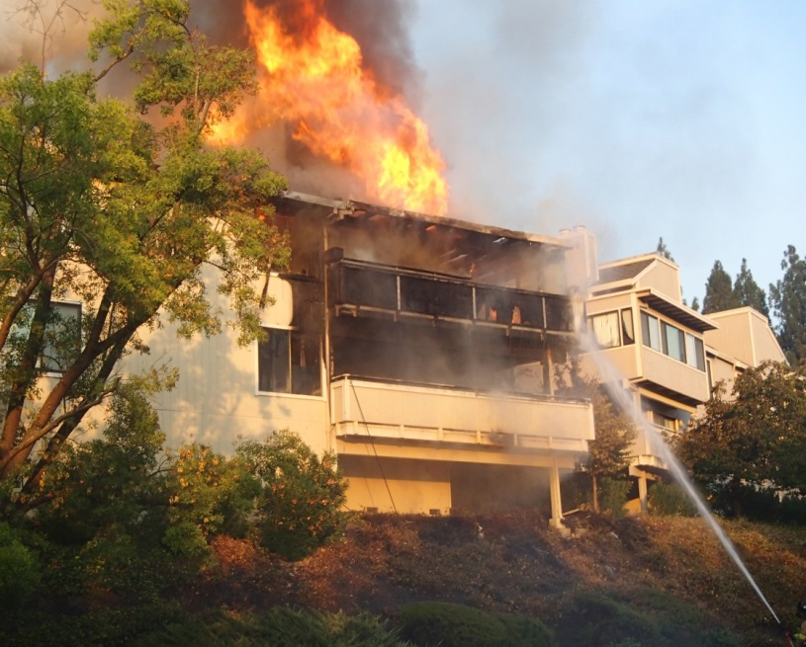
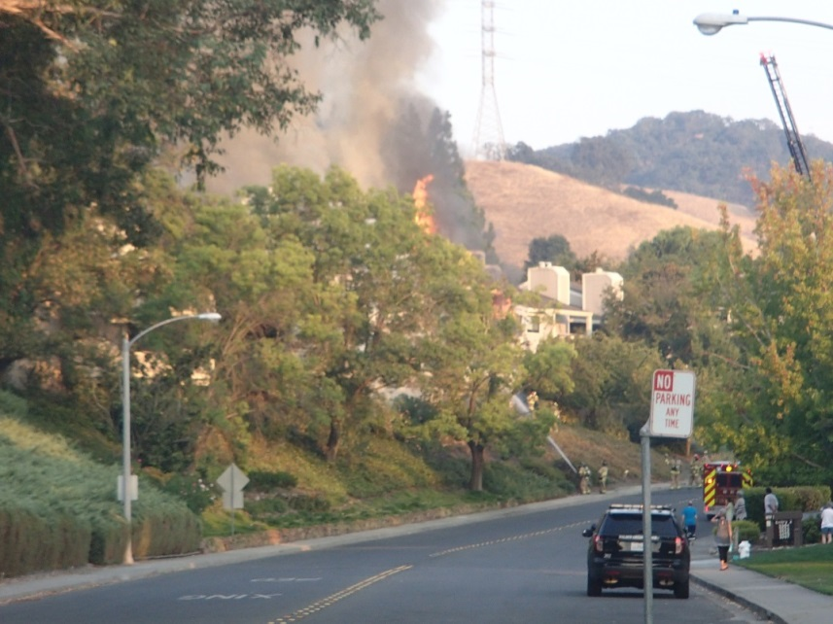
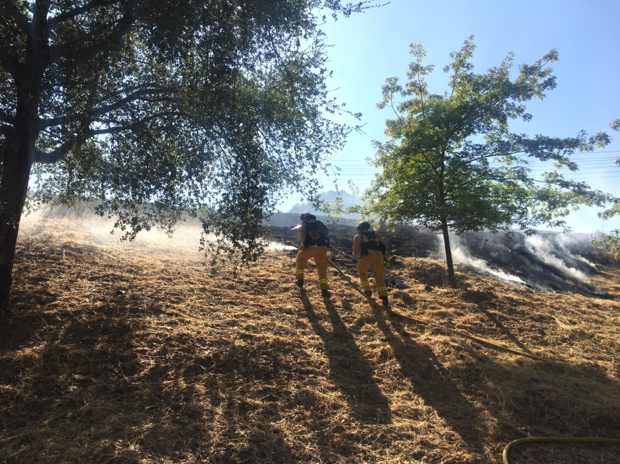
What About Fires?
Notes:
Dennis

Slide 21
Fire Extinguishers Cannot Be Used By Residents
Fire Extinguishers
Use only if safe
Best to get out call 9-1-1
Fire Mitigation Efforts are not up to standards
Wild Fires
Fire Breaks
Exceeds County Requirements
Maintained Yearly
Inspected Yearly
Grass fires have never encroached into Rossmoor
Notes:
Dennis
Securitas Officers also carry fire extinguishers

Slide 22
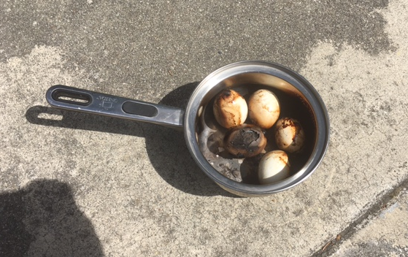
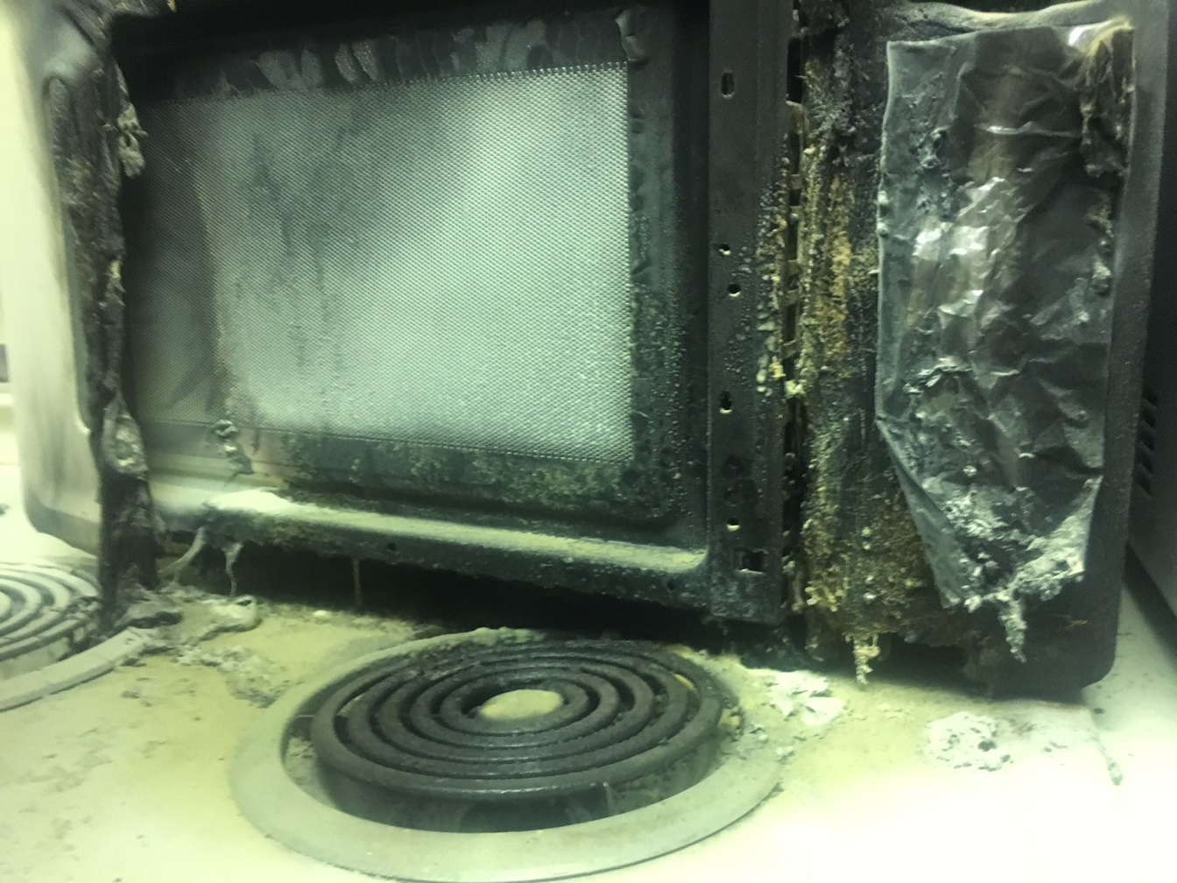
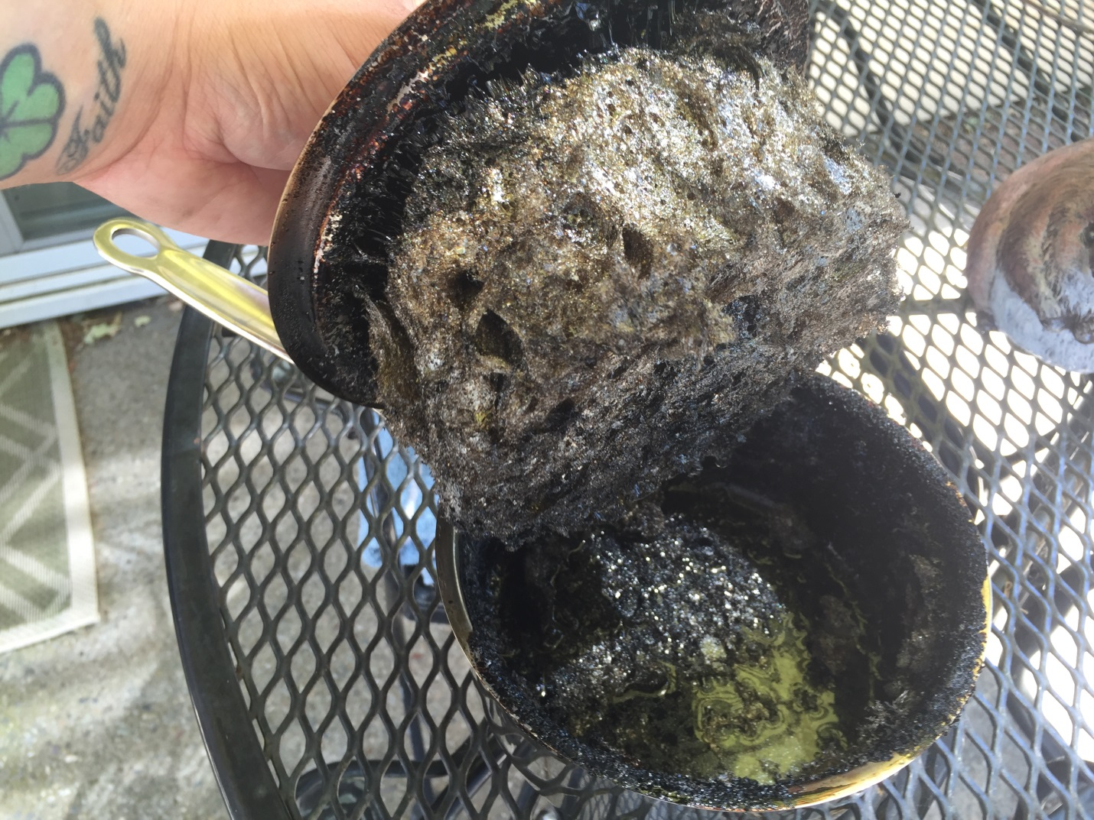
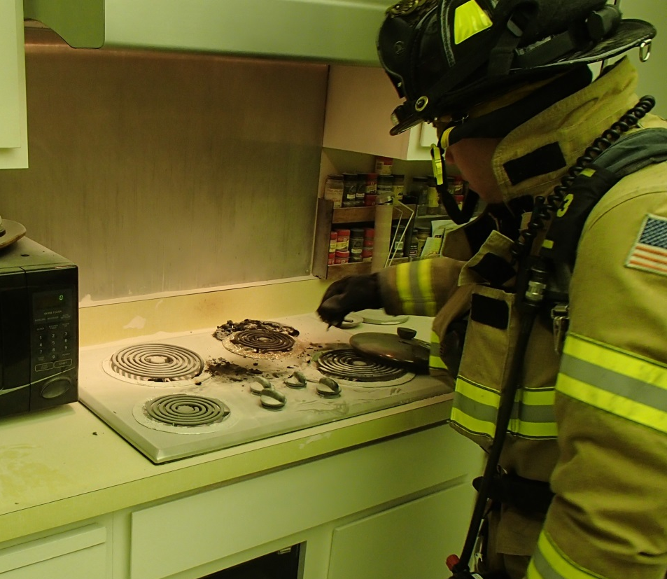
Most Rossmoor Fires are Preventable
Most Common Fires in Rossmoor are Kitchen Fires
Leaving pots on stove, food in oven while away
Ovens are for food!
Not for heating your house, or drying your shoes (true stories)
In most responses for kitchen fires, Securitas Officers were able to extinguish the fire before the Fire Department arrived
Notes:
Molly

Slide 23
A MASS EVACUATION OF ROSSMOOR IS IMMINENT
EVACUATIONS
Valley-wide
Unlikely
Mandatory
When
How
Local
Manor/Building Fire
Gas Leak
Grass Fire
Notes:
Dennis
Teaser for upcoming Emergency activities, plans…

Slide 24
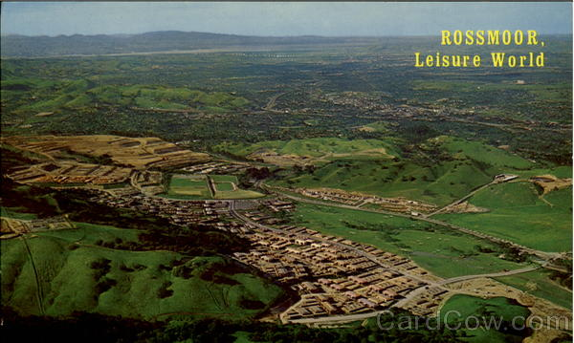
GRF is Keeping Alternate Access Points a SECRET
Notes:
Dennis

Slide 25
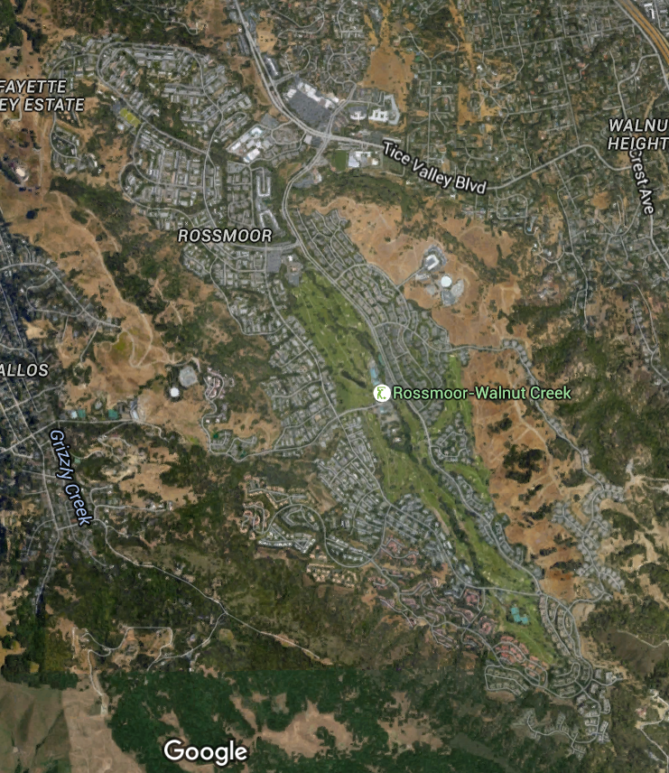
North:
Comstock Drive
Dog Park
Golden Rain Rd. Entries 6/7
East:
Cactus Court Entry 1/2
MOD
South:
Grey Eagle Drive
High Eagle
West:
Skycrest Drive
Stanley Dollar Drive
Notes:
Note: The three north entrances all exit on Tice Valley Blvd and share access roads.

Slide 26
In an Emergency Head to Your Closest Alternative Access Point
Do not go to or use without direction from authorities
You may put yourself in harm’s way
You may interfere with first responders
You may cause more issues/tie up valuable resources
Notes:
Dennis/Molly
Talk about RMP closure

Slide 27
Mass Notifications
www.rossmoor.com
Text/Email/Voice
Notes:
Dennis
Now have over 6,000 registered
Channel 28/ Rossmoor news also a resource

Slide 28
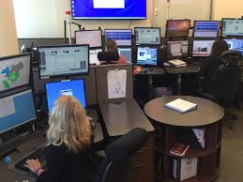
9-1-1 Cell Phone Calls Made in Rossmoor Go to WCPD
Notes:
Dennis

Slide 29
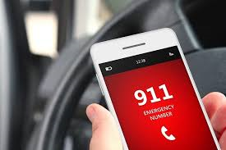
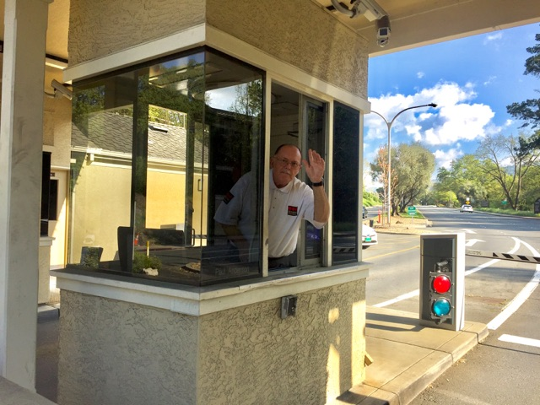
Telephone Numbers
Police/Fire Emergency 9-1-1
Securitas Numbers (24/7)
Emergency 939-0693
Non-Emergency 988-7899
Guest Clearance 988-7843
Notes:
Dennis

Slide 30
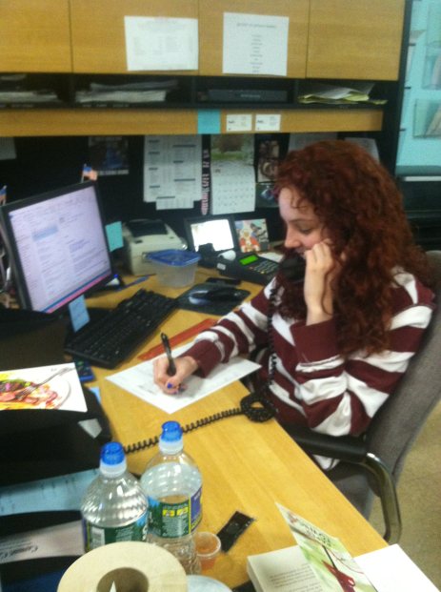
Maintenance Issues
Non-Urgent
Mutual Operations Work Order
E-mail/Phone
workorder@rossmoor.com
988-7650
Urgent
Securitas
939-0693
Notes:
Dennis

Slide 31
Upcoming Emergency Preparedness
GRF Emergency Operation Plan Update
Wildfire Preparation and Planning
Meetings with City of Walnut Creek
Notes:
Evacuation consultants

Slide 32
ASK
DENNIS AND MOLLY

